Slide 1
BIG DATA PROJECT – GROUP 4
Priyanka SaVant
Priyanka Narain
Roshni Arul
Rajathusara Nama
SushantH Chintalapati

Slide 2
PROBLEM STATEMENT & OBJECTIVES
To Load the Truck Fleet data of Az National Trucking into Hive and connect the same to Tableau using Drivers for analysis
To process the data and create analytics reports which create a visual presentation that will benefit decision-making
To determine and analyze the risk factor for each driver and highlight those who have exceeded the specified threshold

Slide 3
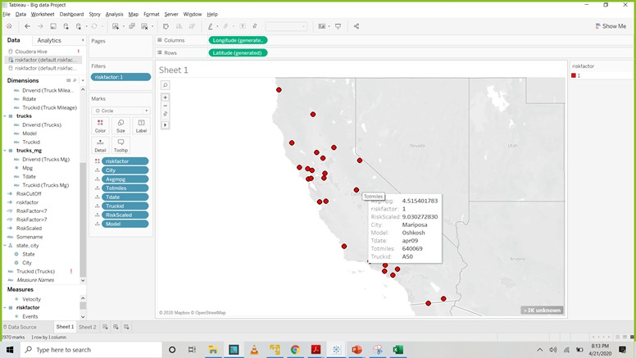
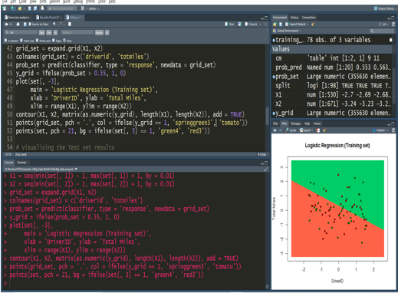
WORKFLOW
Transfer datasets
from local to
Cloudera VM
Loading data into Hive tables
Collecting information
from datasets
Loading the data into Hadoop file system
Creating Geographic Data
Storing data in folder
Creating Hive Tables
Download and install
JDBC and ODBC for
Hive and Impala
Calculating Risk factor
Visualization and Logistic Regression
Integrating HDFS with Tableau
Create chart to visualize
the riskfactor
Connect to Cloudera Hadoop server using IP Address and Port
number
Training Set

Slide 4
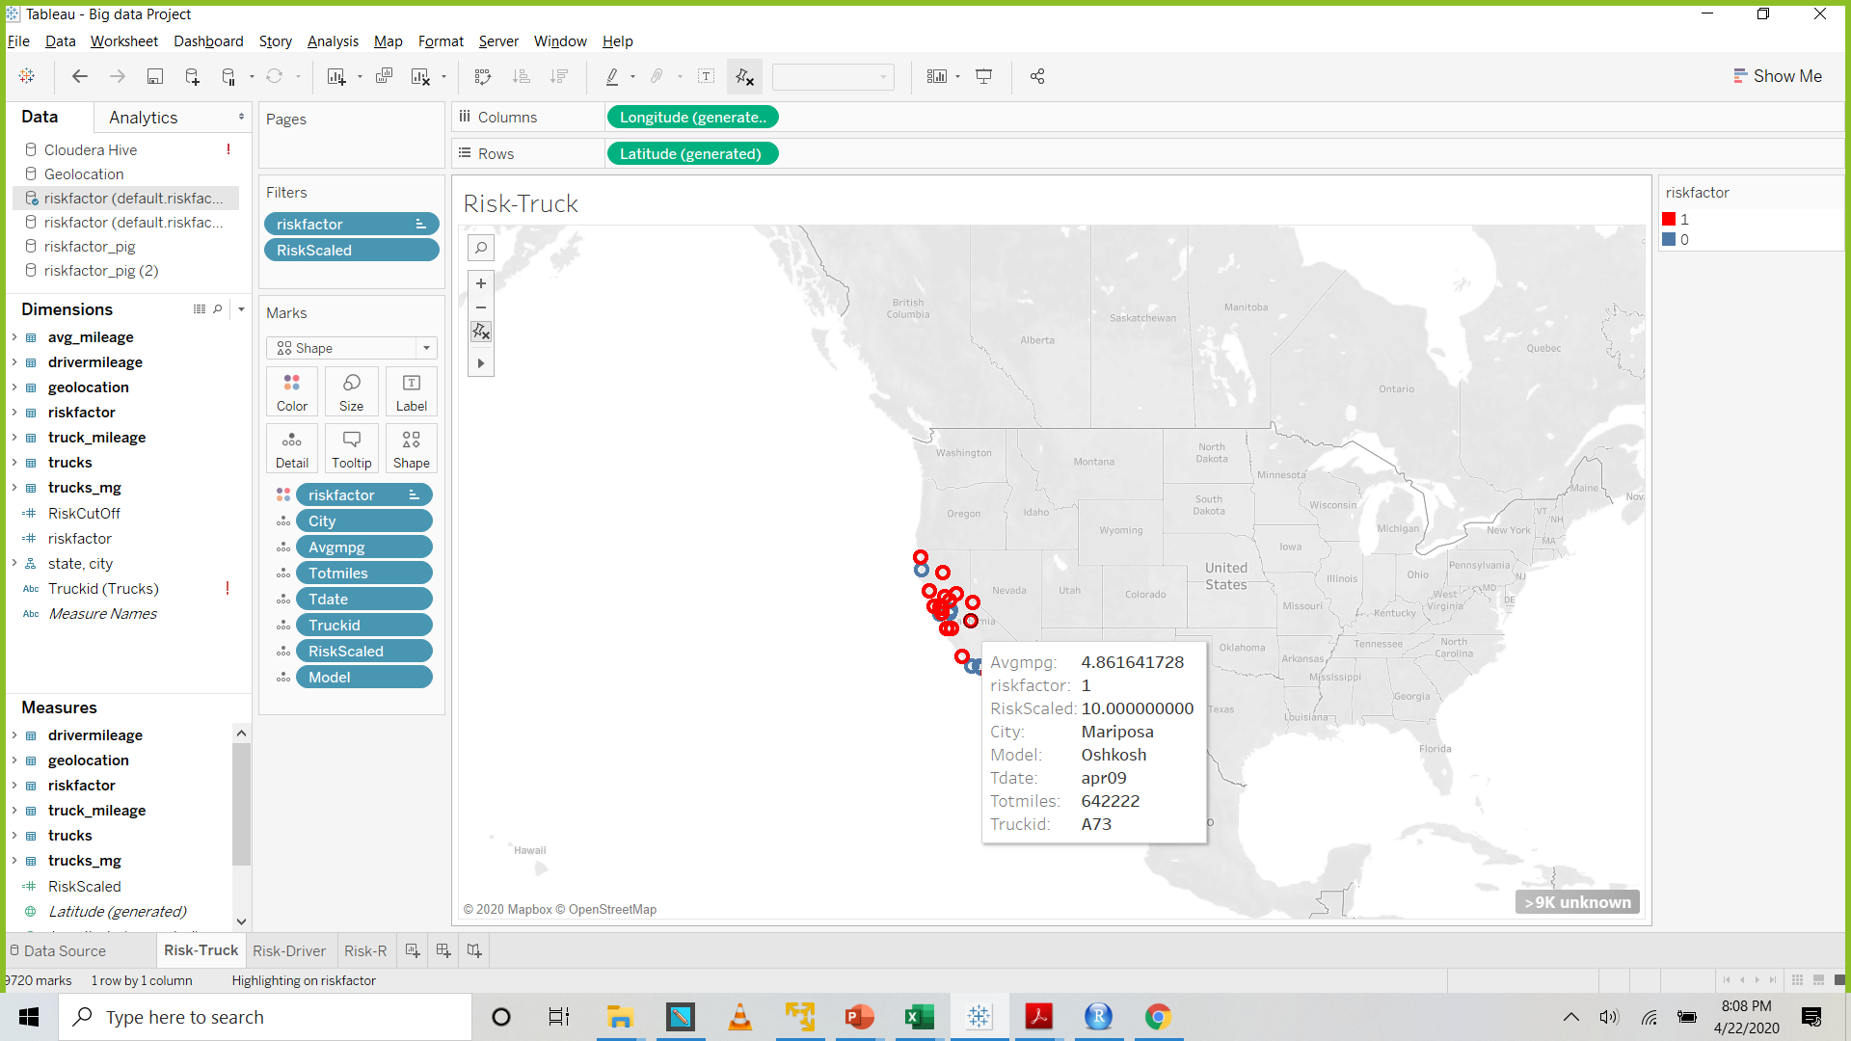
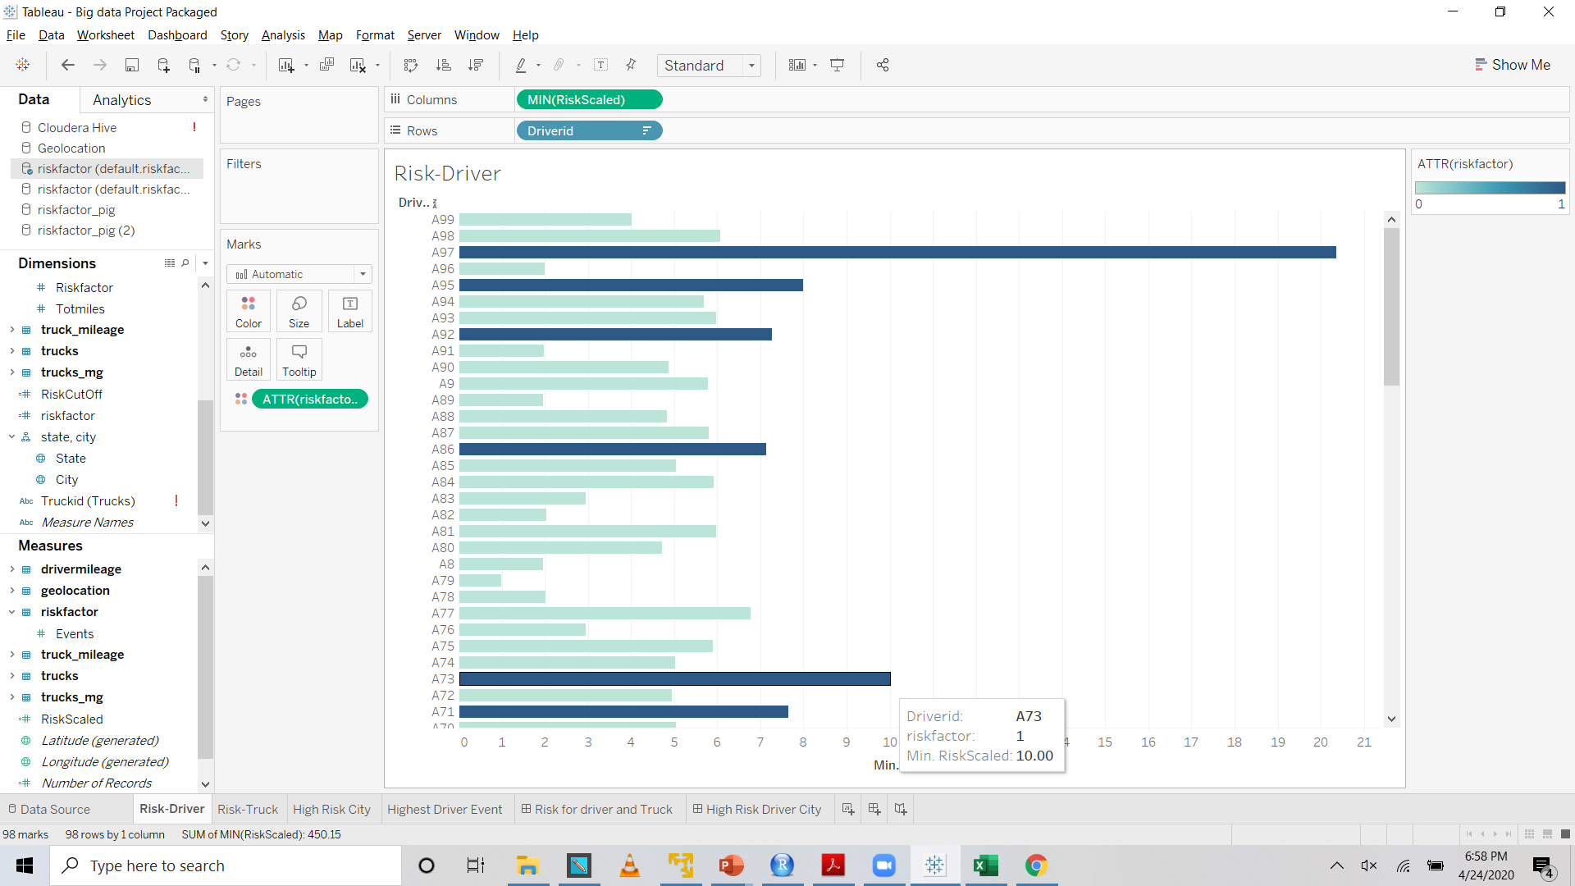
DASHBOARD VISUALIZATION IN TABLEAU
This visualization depicts the risk factor associated with each driver(on a scale of 10) with the red bars highlighting risk factors greater than 7 and the drivers for whom an alert would be sent to the insurance company. Driver Id # A73 has a risk factor of 10 suggesting highest number of events.
Truck id # A73 – (Oshkosh model) drove a total of 642,222 miles in the city of Mentosa in the month of April of 2009 with an average of 4.8 mpg and a risk factor of 10

Slide 5
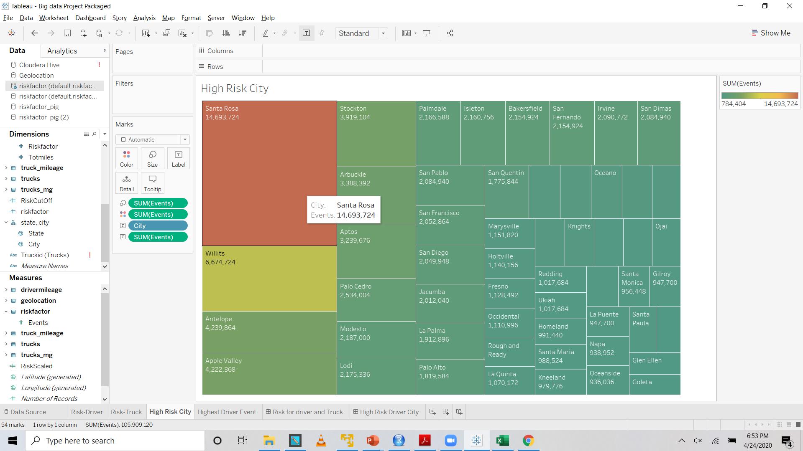
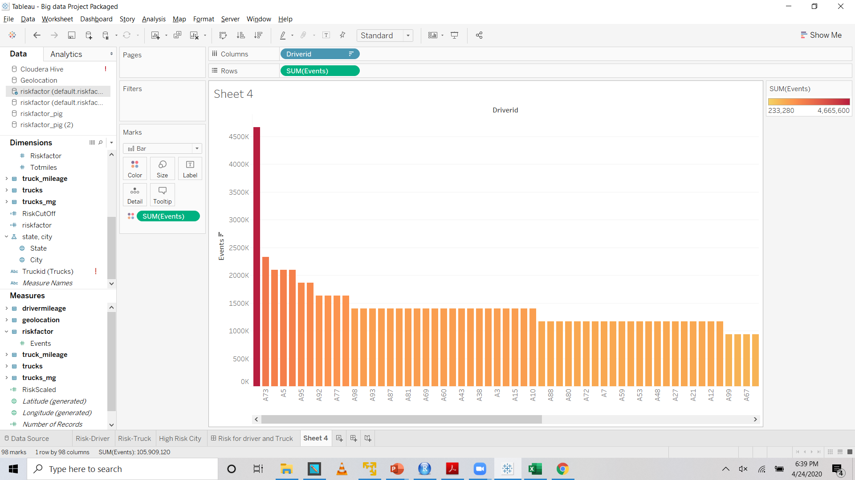
We can see that the city of Santa Rosa has the highest number of events of 14,693,724 and so the drivers need to be monitored.
Visualizing drivers associated with highest number of events. Drive A97 and A73 are reported to have highest number of events.

Slide 6
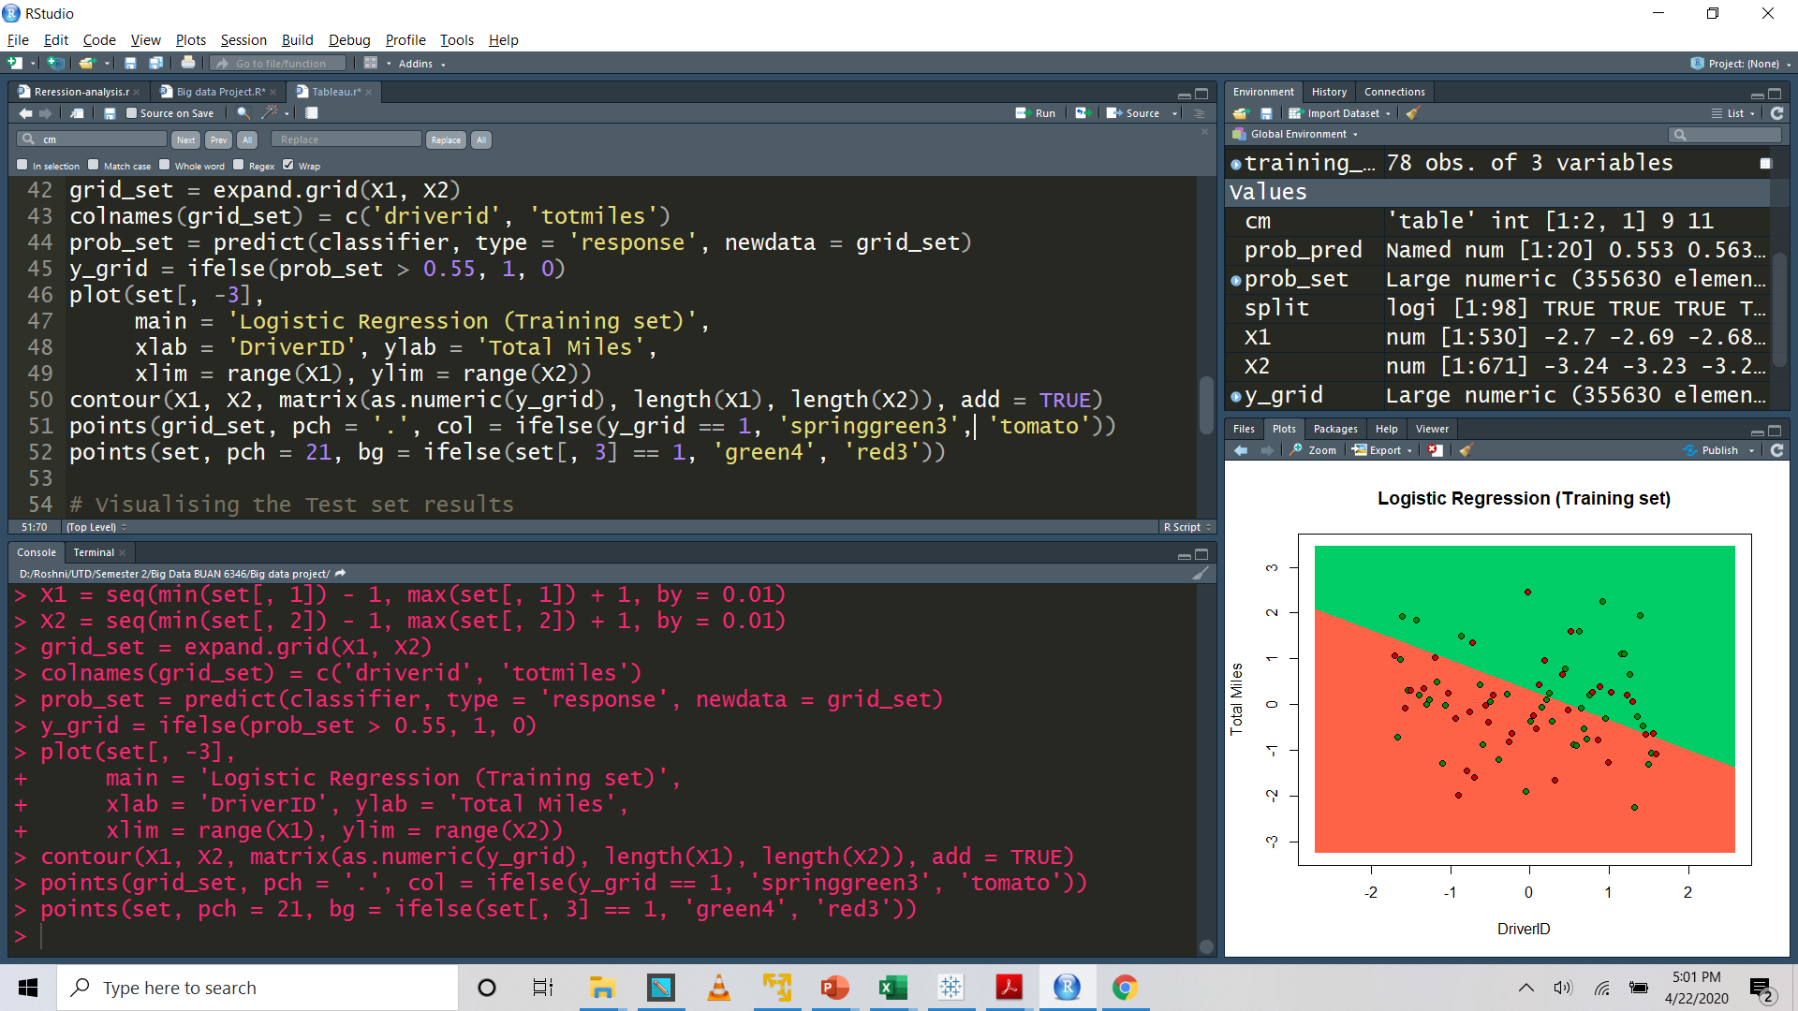
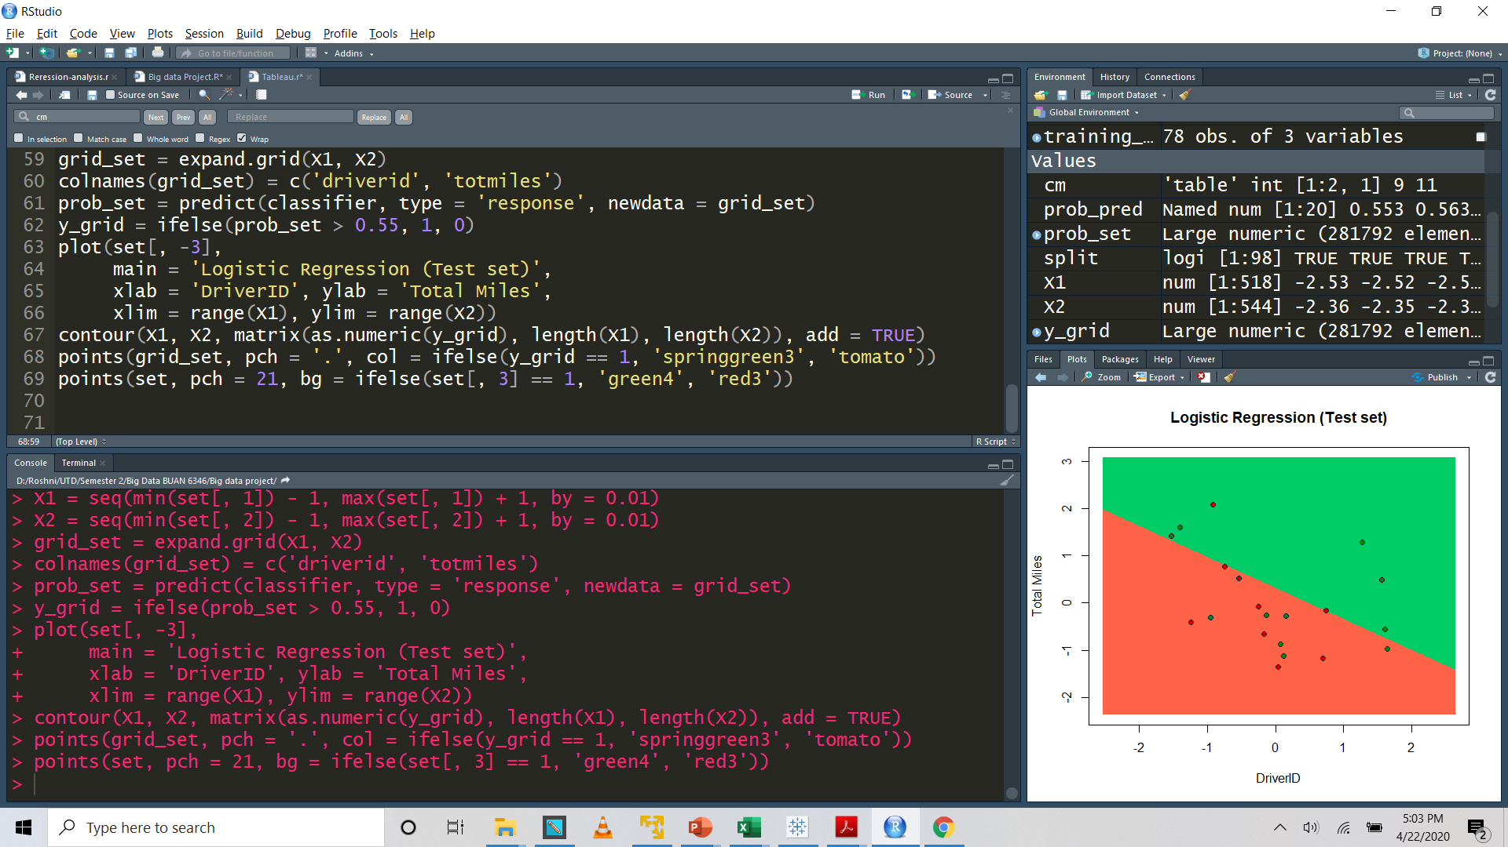
LOGISTIC REGRESSION
TRAINING SET
TEST SET

